Slide 1
Recitation 2

Slide 2
CHANGE IN OFFICE HOURS
Wednesday 5-6 in Hill 254 (Meltdown lab by the Cave)
Changed my office hours location to the Meltdown lab b/c Rutgers threw all the undergraduate TAs into one office but didn’t even give us the keys to it and there’s a bunch of other problems I don’t want to deal with
WILL NOT BE HAVING OFFICE HOURS OCTOBER 2, will be in Orlando for a CS conference

Slide 3
Recitation Schedule
Practice Problems from Chapters 1.2-1.3
Representing Sentences with Propositional Variables: 1.2 1, 2, 4
Logic Circuits: 1.2 #40, 42
Logical Equivalences: 1.3 #1, 2, 8, 14, 30
Time for questions at the end of recitation

Slide 4
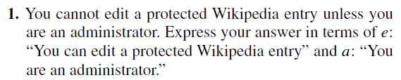
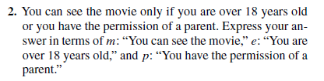
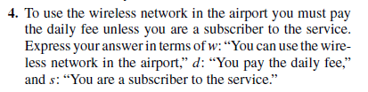
1.2 #1,2, 4
Notes:
1) How can we rephrase this to make it easier to write? “If you are not an administrator, then you cannot edit a protected Wikipedia entry” OR “If you can edit a protected Wikipedia entry, then you are an administrator”
2) How can we rephrase this to make it easier to write? “If you can see the movie, then you are over 18 years old or you have the permission of a parent”
IT IS NOT “IF YOU HAVE THE PERMISSION OF A PARENT OR IF YOU’RE 18 YEARS OLD THEN YOU CAN SEE THE MOVIE” SOMEONE CAN BE 18 YEARS OLD BUT THEY ARE BLIND, SO THEY CANNOT SEE THE MOVIE.
4) How can we rephrase this to make it easier to write? “If you can use the wireless network in the airport, then you pay the daily fee or are a subscriber to the service.

Slide 5
1.2 #1, 2, 4 Answers
1) ¬a → ¬e WHICH IS THE CONTRAPOSITIVE OF e → a
2) m → (e ∨ p)
4) w → (d ∨ s)

Slide 6
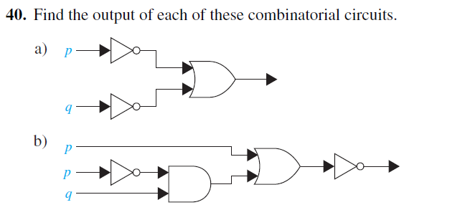
1.2 #40
Notes:
Start by evaluating the smaller parts of the circuit first and then building up from there

Slide 7
1.2 #40 Answer
a) ¬p ∨ ¬q
b) ¬((¬p ∧ q) ∨ p)

Slide 8

1.2 #42

Slide 9
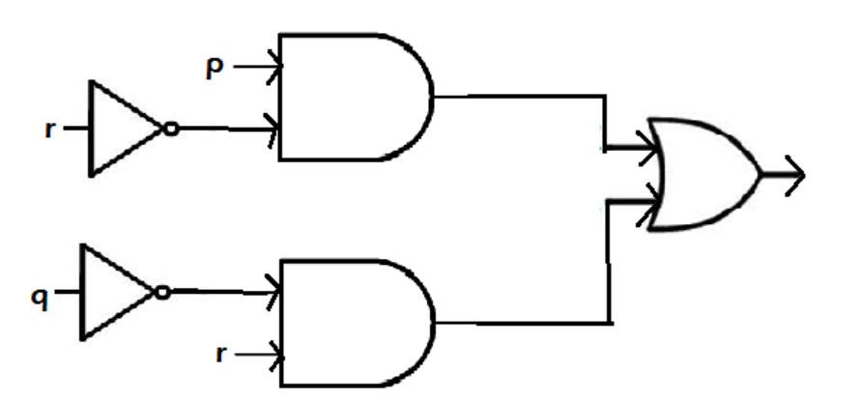
1.2 #42 Answer

Slide 10
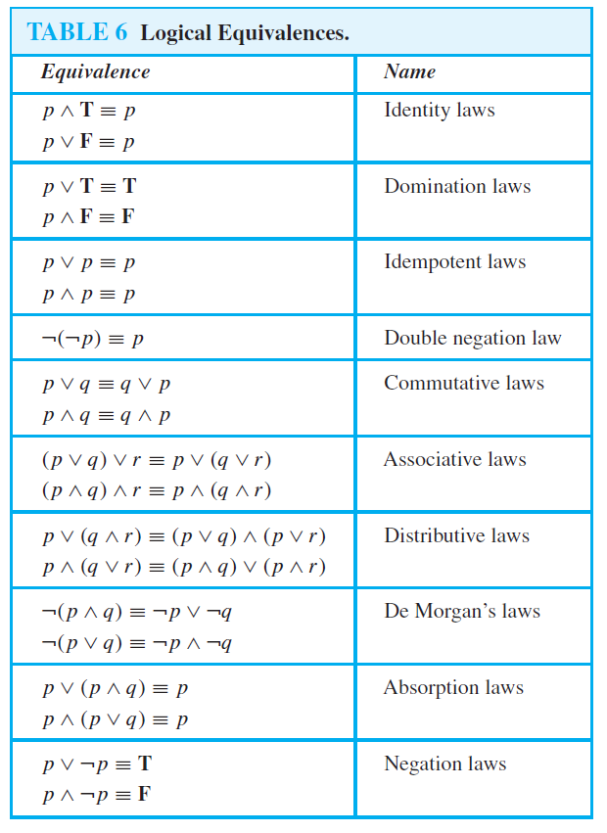
CHAPTER 1.3
Quizlet: https://quizlet.com/371724404/13-propositional-equivalences-flash-cards/

Slide 11
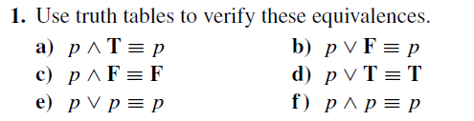
1.3 #1 a-c

Slide 12
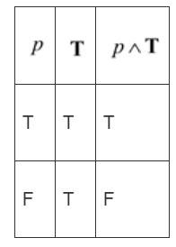
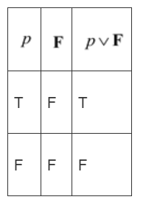
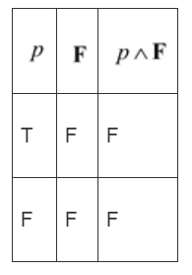
1.3 #1 Answers
a) b) c)

Slide 13
1.3 #2

Slide 14
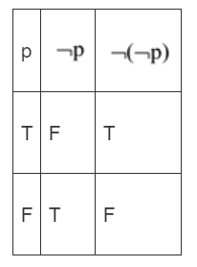
1.3 #2 Answer

Slide 15
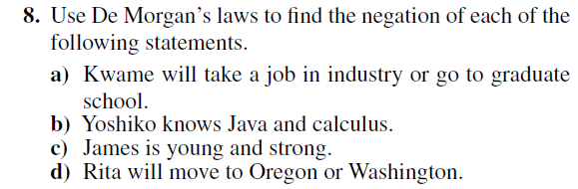
1.3 #8
Notes:
We want to represent these problems using propositional variables.
a) Let p = Kwame will take a job in industry, q = Kwame will go to graduate school
Thus we can represent the sentence as (p ∨ q)
After negation: ¬(p ∨ q)
Distribute negation: ¬p ∧ ¬q
The new sentence is “Kwame will not take a job in industry AND will not go to graduate school”
How does, “and”, “or” change when using De Morgan’s laws? They are switched
∨ becomes ∧
∧ becomes ∨

Slide 16
1.3 #8
a) Kwame will not take a job in industry and go to graduate school.
b) Yoshiko does not know Java or calculus.
c) James is not young or not strong.
d) Rita will not move to Oregon and Washington.

Slide 17

1.3 #14
Notes:
Tautology means that something is ALWAYS TRUE
There are two ways to prove if a logical expression is a tautology: by making a truth table or by using logical equivalences.
Let’s use a truth table to solve this.

Slide 18
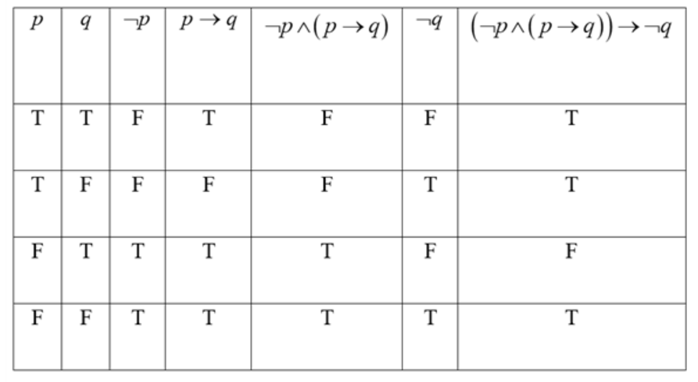
1.3 #14 Answer
NOT A TAUTOLOGY because the last column of the truth table is not all true

Slide 19
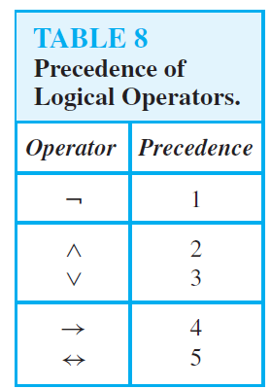
1.3 #30

Slide 20
1.3 #30 Answer
IT IS A TAUTOLOGY. Proved using logical equivalences in the comment section of this powerpoint. Truth Table:
p | q | r | p ∨ q | ¬p | ¬p ∨ r | (p ∨ q) ∧ (¬p ∨ r) | q ∨ r | [(p ∨ q) ∨ (¬p ∨ r)] -> (q ∨ r)
T | T | T | T | F | T | F | T | T
T | T | F | T | F | F | F | T | T
T | F | T | T | F | T | T | T | T
T | F | F | T | F | F | F | F | T
F | T | T | T | T | T | T | T | T
F | T | F | T | T | T | T | T | T
F | F | T | F | T | T | F | F | T
F | F | F | F | T | T | F | F | T
Notes:
1) Get rid of the implication.
¬[(p ∨ q) ∧ (¬p ∨ r)] ∨ (q ∨ r)
*EVERYTHING BEFORE THE ARROW MUST BE NEGATED BECAUSE OF PRECEDENCE
2) If you have any not symbols in front of parentheses, use Demorgan's to distribute
[¬(p ∨ q) ∨ ¬(¬p ∨ r)] ∨ (q ∨ r)
(¬p ∧ ¬q) ∨ (p ∧ ¬r) ∨ (q ∨ r)
3) Associative/Rearrange:
(¬p ∧ ¬q) ∨ (p ∧ ¬r) ∨ q ∨ r
We are allowed to remove the parentheses around “q ∨ r” because of the associative rule. The variables in the parentheses, q, r are all combined with the “∨” symbol so we are allowed to remove the parentheses around q,r
(¬p ∧ ¬q) ∨ q ∨ (p ∧ ¬r) ∨ r
[(¬p ∧ ¬q) ∨ q] ∨ [(p ∧ ¬r) ∨ r]
We want to rearrange q and r so that q is grouped with not q and r is grouped with not r so we can simplify them later on
4) Distribute q and r:
[(¬p ∨ q) ∧ (¬q ∨ q)] ∨ [(p ∨ r) ∧ (¬r ∨ r)]
5) Negation Law:
[(¬p ∨ q) ∧ (T)] ∨ [(p ∨ r) ∧ (T)]
6) Distribute T:
[(¬p ∧ T) ∨ (q ∧ T)] ∨ [(p ∧ T) ∨ (r ∧ T)]
7) Identity Law:
[¬p ∨ q] ∨ [p ∨ r] Remove the parentheses
¬p ∨ q ∨ p ∨ r Rearrange
(¬p ∨ p) ∨ q ∨ r
8) Negation Law:
T ∨ q ∨ r
9) Domination Law:
T ∨ r
T Q.E.D. The propositional expression is a tautology

Slide 21
Summary
To represent a sentence in propositional variables, end state guarantees that one of the requirements were met because you HAVE to meet them to get to the end state, thus p = end state and q = requirements (p → q)
Logic circuits: click here for symbols, start building the circuit small and then expand on it
Logical Equivalence Laws: if you don’t remember what the outcome of a specific law is, draw a truth table for it!
Proving whether or not something is a tautology: you can use logical equivalences or make a truth table

Slide 22
ADDITIONAL SLIDES

Slide 23
Distributive Rule for 4 variables
I DO NOT RECOMMEND USING THE DISTRIBUTION RULE FOR 4 VARIABLES HOWEVER someone asked about it and I think it’s still nice to know
(p ∧ q) ∨ (r ∧ s)
1) Distribute “∨ (r ∧ s)” to p and q
[p ∨ (r ∧ s)] ∧ [q ∨ (r ∧ s)]
2) Distribute “p ∨” to “(r ∧ s)” and “q ∨” to “(r ∧ s)”
[(p ∨ r) ∧ (p ∨ s)] ∧ [(q ∨ r) ∧ (q ∨ s)]
3) You can get rid of the [ ] brackets based on the associative law (WE CAN ONLY DO THIS FOR THE SQUARE BRACKETS BECAUSE ALL THE STUFF IN THE ( ) PARENTHESES ARE COMBINED TOGETHER BY AN AND SYMBOL)
(p ∨ r) ∧ (p ∨ s) ∧ (q ∨ r) ∧ (q ∨ s)
Notes:
You can use the associative rule for
p ∧ q ∧ r
But you cannot use the associative rule for
p ∧ q ∨ r
because they are not joined together by the same symbol

